Slide 1
Modern Standards for Measuring Contact Center Quality
October 13, 2017
Presented by Justin Robbins
Sponsored by NICE

Slide 2


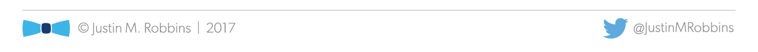
Your Presenters:
Justin Robbins
justin@justinmrobbins.com
Lauren Maschio
lauren.maschio@nice.com

Slide 3

Did You Know?
Statistically speaking, it’s actually safer than most days
Whether this is because people are staying at home, fearfully tucked in bed, seems unlikely, but the Dutch Centre for Insurance Statistics conducted a study in 2008 that showed there were fewer traffic accidents, fires and robberies on Friday the 13th, compared to other Fridays.
It’s not unlucky for Taylor Swift
“I was born on the 13th. I turned 13 on Friday the 13th. My first album went gold in 13 weeks. My first No.1 song had a 13-second intro,” Swift told MTV in 2009. “Every time I’ve won an award, I’ve been seated in either the 13th seat, the 13th row, the 13th section or row M, which is the 13th letter.”

Slide 4
Today’s Agenda
Insights on the current state of quality management
Defining QM’s business case and return on investment
Getting started with measuring quality in new channels
Leveraging quality as a strategic business asset

Slide 5
The Survey Says…
Quality is inconsistently monitored across channels
It’s a highly manual and cumbersome process
There isn’t alignment between QA and training
Most agents don’t find QA helpful to their success

Slide 6
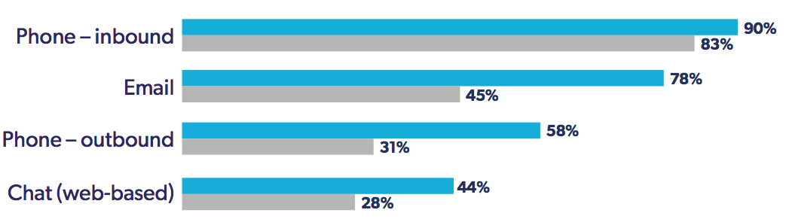
The QA Gap

Slide 7
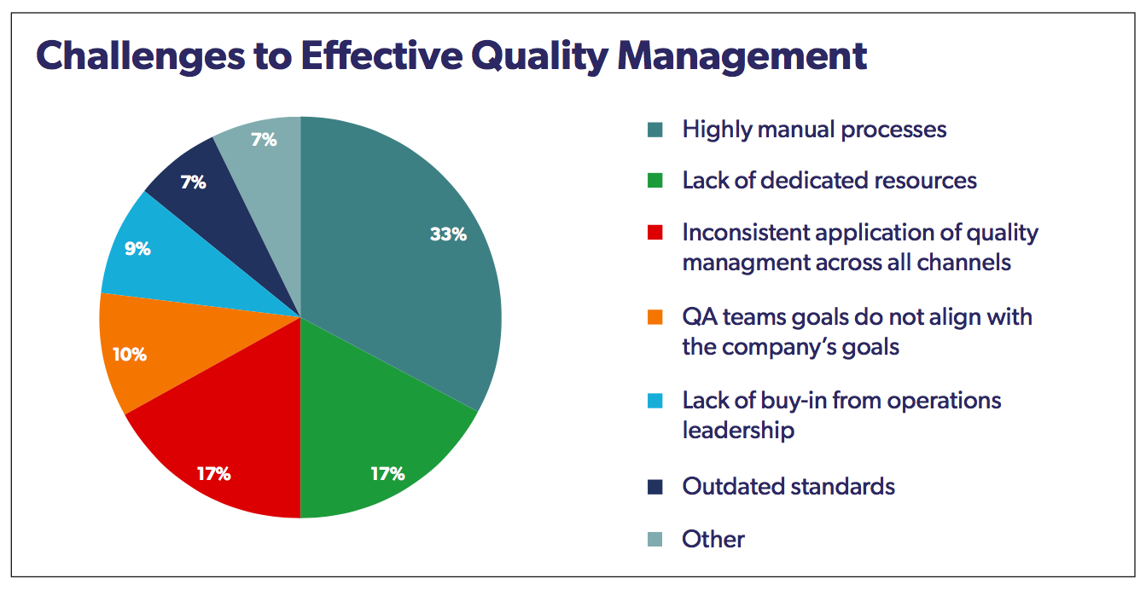

Slide 8
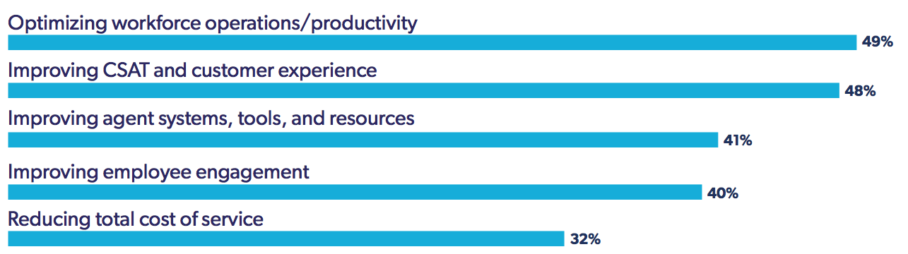
Key Business Initiatives

Slide 9
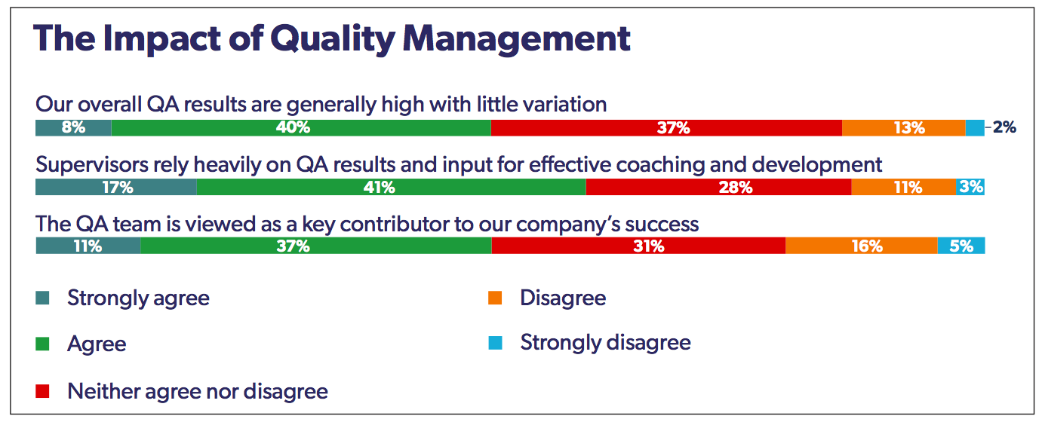

Slide 10
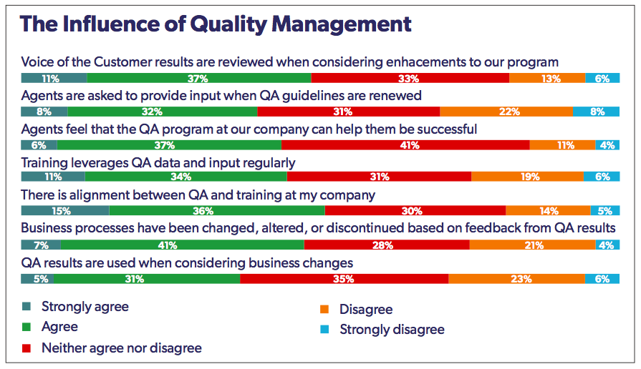

Slide 11
NICE Quality Management Solutions
Evaluate
Fully Automated Omni-Channel Solutions for Contact Centers of All Sizes
Measure
Calibrate
Coach
visor/evaluatbrate on
Quality Central
QM
Hosted or On-Premise
Complex Requirements
Fully customize
NICE Enterprise WFO suite
Cloud SaaS
Simple, Intuitive
Turnkey
NICE CXone WFO suite

Slide 12
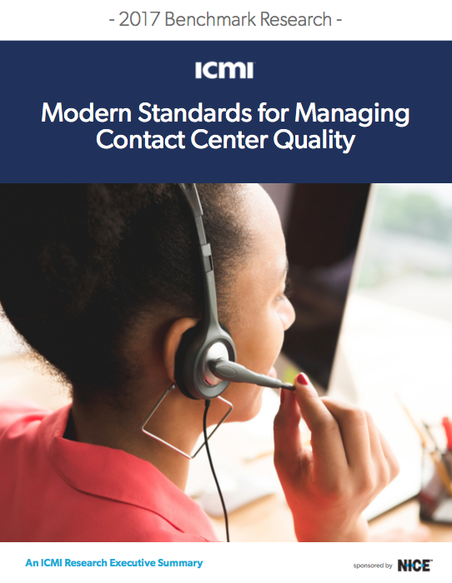
Download the Report:
http://bit.ly/NICEQMResearch

Slide 13
Thank You!
Questions?

